Slide 1

Clustering of time series using topological data analysis
Pilyugina Polina
Shvetsov Nikolay
Vlasov Andrei
Talitsky Alexandr

Slide 2
Problem statement
Articles:
T. Lacombe, M. Cuturi, and S. Oudot, “Large Scale computation of Means and Clusters for Persistence Diagrams using Optimal Transport”
L. M. Seversky, S. Davis, and M. Berger, “On Time-Series Topological Data Analysis: New Data and Opportunities”
Problem:
Application of topological data analysis to commercial time series
Clustering of time series based on persistence diagrams
Possible solution:
Iterative methods for solving optimal transport problem and approximation of distances and barycenters in the space of persistence diagrams

Slide 3
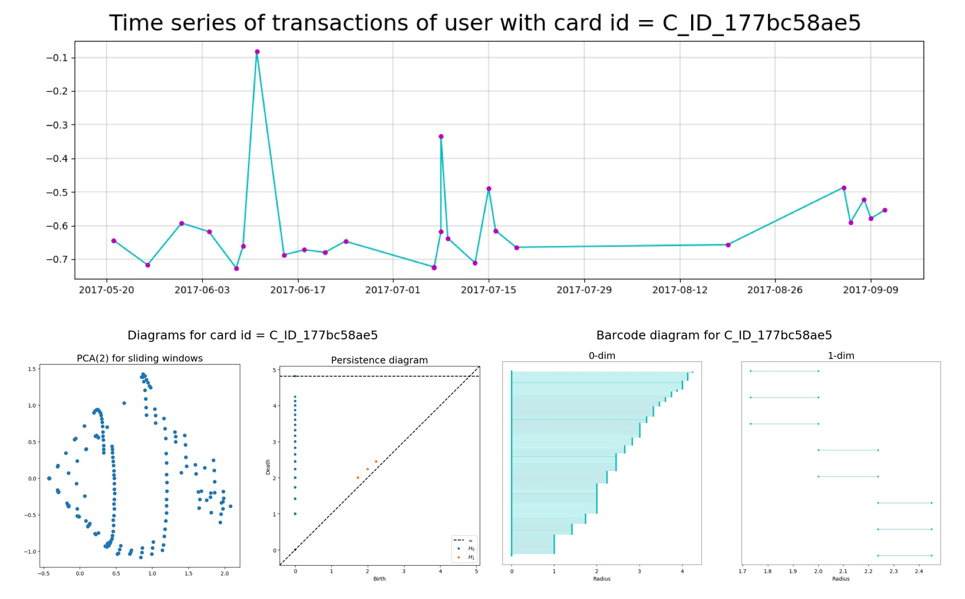
Pipeline for creation of persistence diagrams
Sliding window embedding
Point cloud creation
Persistence diagrams

Slide 4
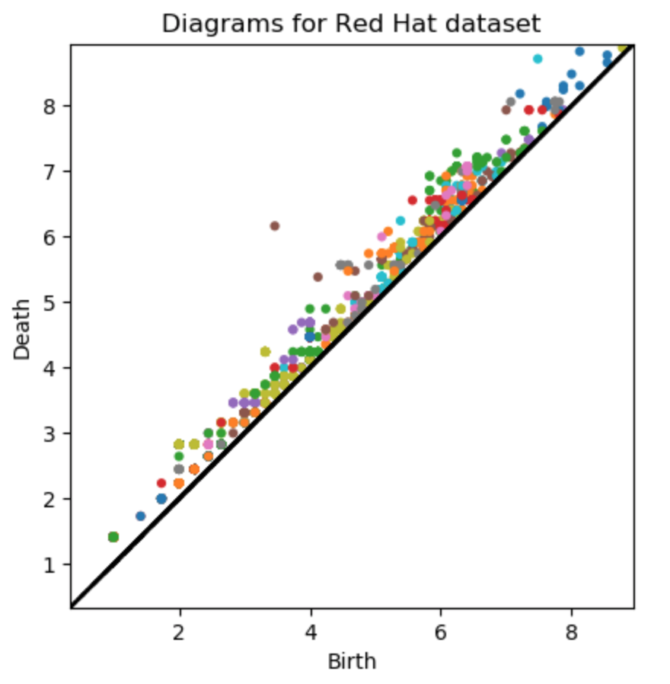
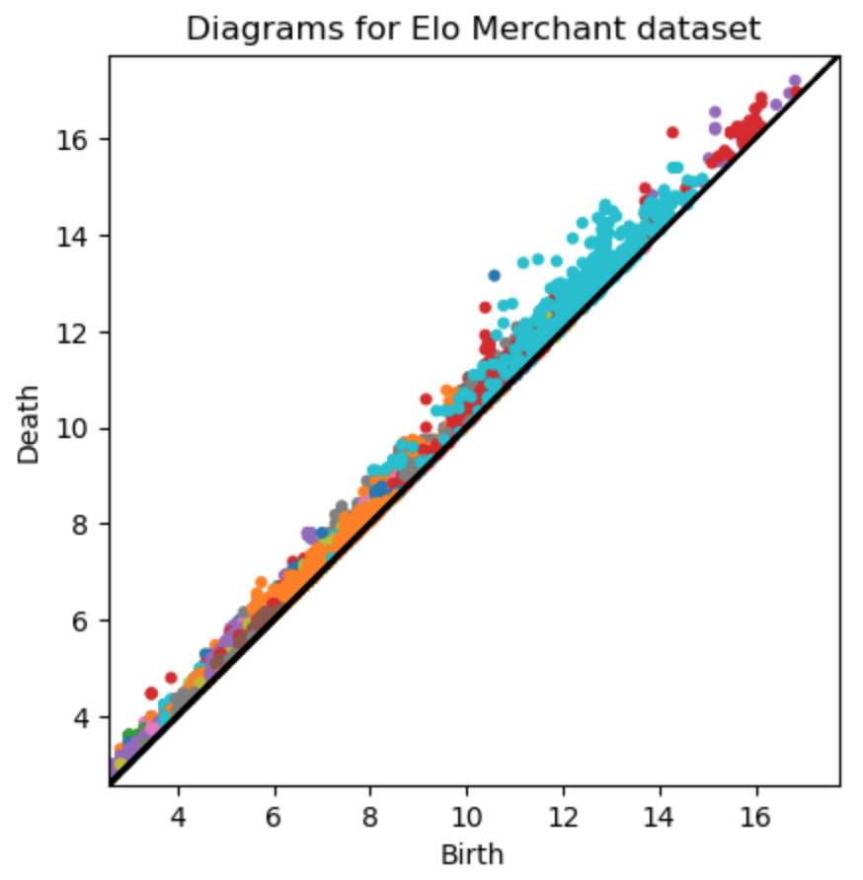
Persistence diagrams for real data

Slide 5
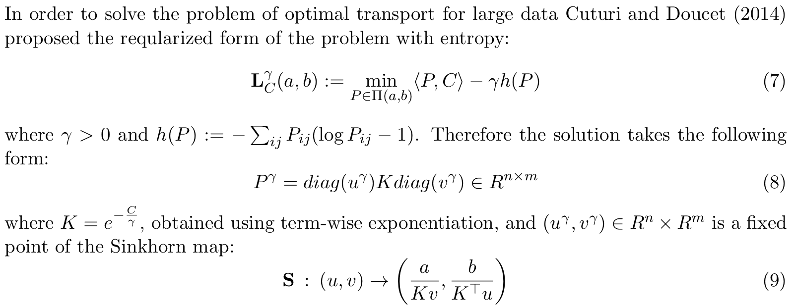
Relevant formulas

Slide 6
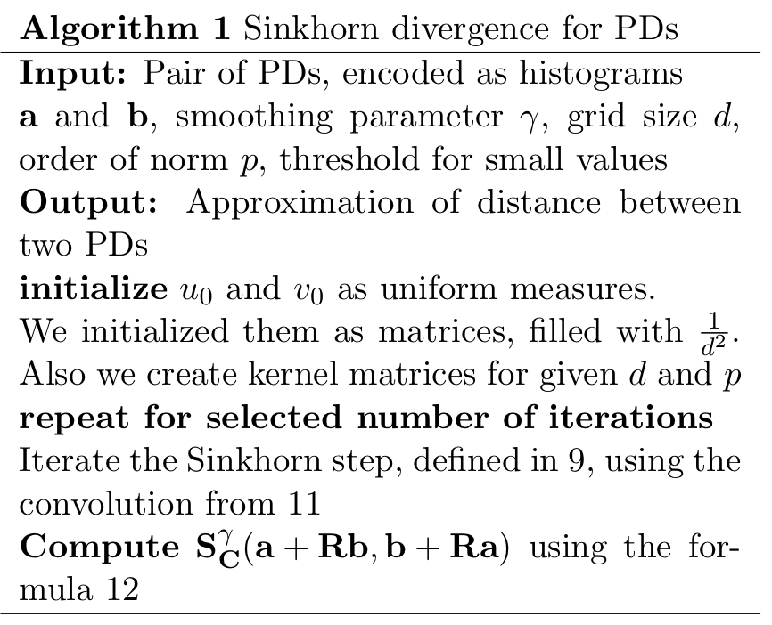
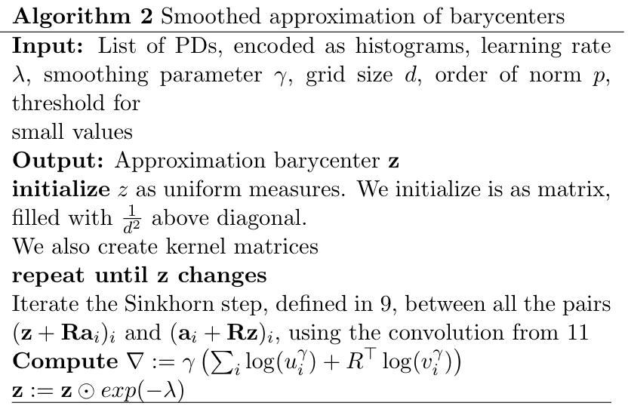

Algorithms

Slide 7
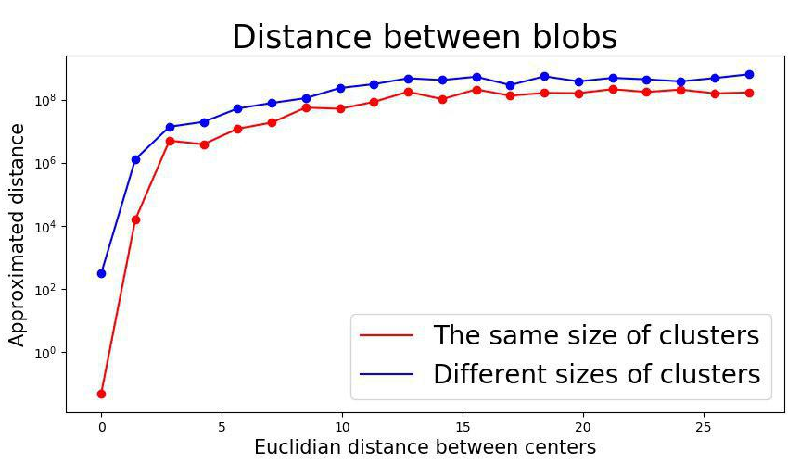
Tests of distance approximation on artificial data

Slide 8
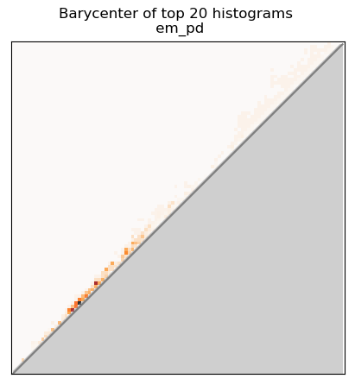
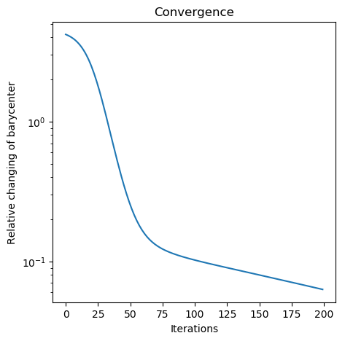
Barycenter approximation

Slide 9
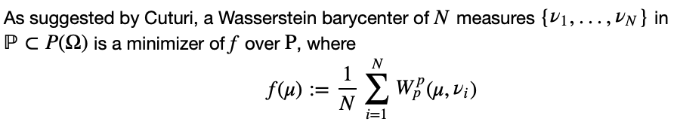
Wasserstein barycenters for artificial blobs

Slide 10
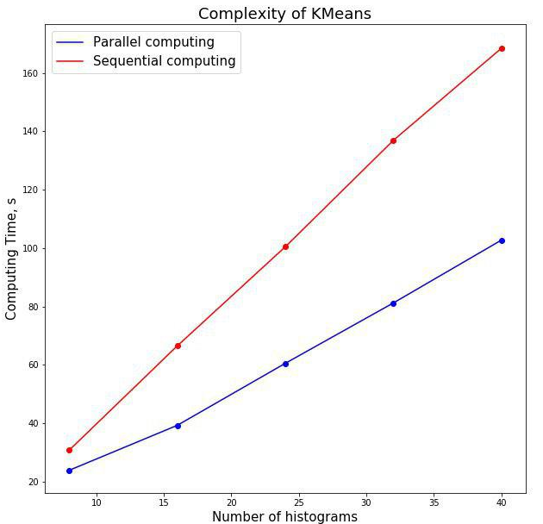
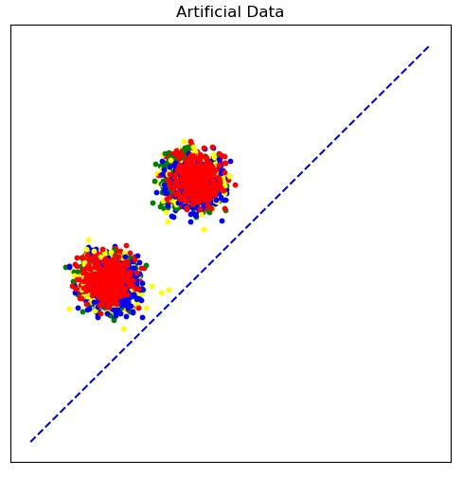
K-means clustering

Slide 11
Conclusions
Wasserstein distances and barycenters are not applicable to the clustering of PDs
Algorithm from the paper indeed approximated distances and barycenters, which can be used in k-means, but:
It harshly depends on the data
It is numerically unstable
Algorithm allows to apply parallelization, which decreases computational time significantly
Application of the algorithm to real data is ambiguous

Slide 12
Thank you for attention!

Slide 13
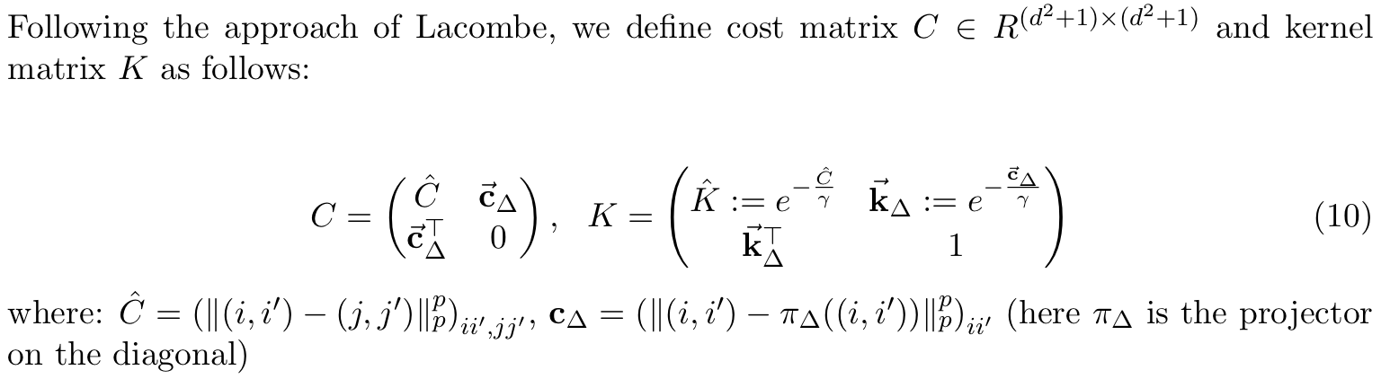
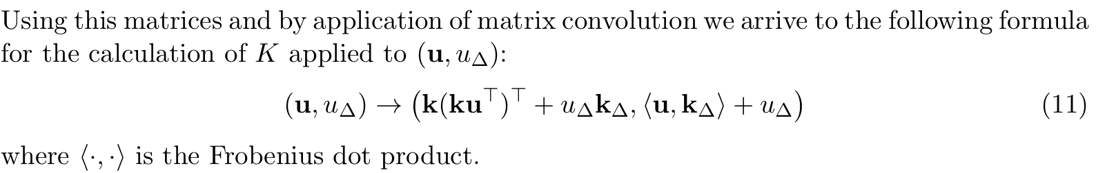
Relevant formulas

